Slide 1


Slide 2
Dynamic Host Configuration Protocol (DHCP)
Is a client/server protocol that automatically provides an Internet Protocol (IP) host with its:
IP address
subnet mask
default gateway
DNS Servers
NTP Servers

Slide 3
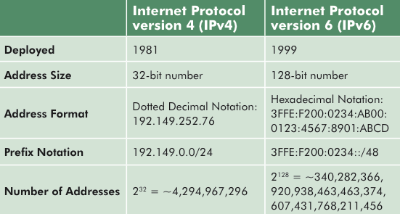

Slide 4
